Slide 1
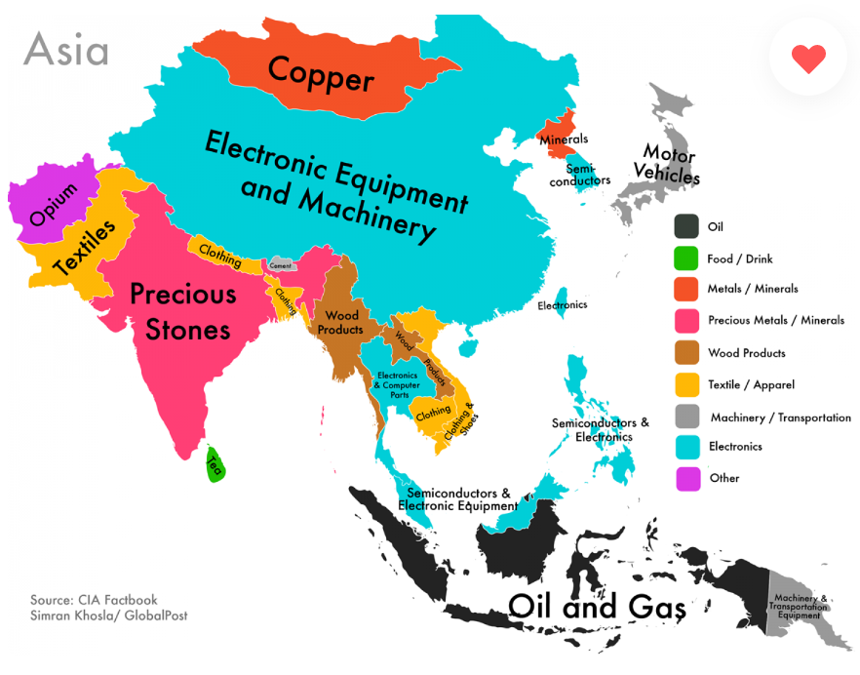
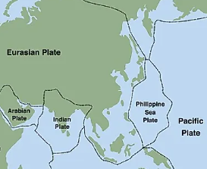
Asia Deep Dive
Geography Knowledge Organiser
Year 6: Summer Term A
Key Knowledge
Asia is the largest continent. It is divided into five varied regions. Due to its size and physical geography Asia has a wide range of climates and biomes including deserts, mountains, tropical and sub-tropical jungle, temperate forests, tiago and temperate grasslands. Asia is the birthplace of Judaism, Christianity, Islam, Hinduism, Sikhism and Buddhism. Many people of faith make pilgrimages to sacred religious sites in Asia. As a result there are many key religious sites in Asia such as Mecca and Medina in Saudi Arabia, Jerusalem in Israel and the Ganges River in India. The Silk Road was an ancient network of trade routes that connected China to the Mediterranean Sea.. Partition refers to the division of a country or region into separate parts, often along religious or political lines. India was ruled by the British Empire for over 200 years. In the early 20th century, there were growing calls for independence from British rule, led by figures such as Mahatma Gandhi. The partition of India in 1947 led to the creation of two separate countries: India (majority Hindu) and Pakistan (majority Muslim). Some countries in Asia, such as Japan and South Korea, have developed modern, industrial economies, which export goods around the world while others, such as Afghanistan and Nepal, still have traditional, subsistence-based economies. Asia has many tectonic plate boundaries. Where tectonic plates meet they can cause many types of natural disaster, such as earthquakes and tsunamis.
Vocabulary
Biome | Areas of the planet with a similar climate and landscape, where similar animals and plants live.
Pilgrimage | A journey. to a holy place is called a pilgrimage.
Partition | A change of political borders cutting through at least one territory considered a homeland by some community.
Economy | The system of production, distribution, and consumption of goods and services.
Export | Sending goods to sell in other countries
Tectonic plate boundaries | Broken large pieces of the Earth's crust and upper part of the mantle
Natural disasters | Natural disasters are caused by nature, such as tornadoes, ice storms, severe weather and flooding.

