Slide 1
Words are Fun!
He didn't tell his mother that he had eaten the glue.
His lips were sealed.

Slide 2
Developing Reading
Isle of Ely Parent Share Session: Thursday 7th March

Slide 3
WhY is reading so important?
“If children leave my school and can’t
paint that’s a pity but if they leave and
can’t read that’s a disaster.”
Head teacher quoted in Rose
(2008, p42)

Slide 4
WhY is reading so important?
Numerous international research studies have found that the most important factor in academic success was the amount of time pupils spend reading – not whether books, magazines, newspapers, websites and so on, but that they were actually reading.
This research also showed the amount of time spent reading books specifically was the most profitable in the increase of academic success.

Slide 5
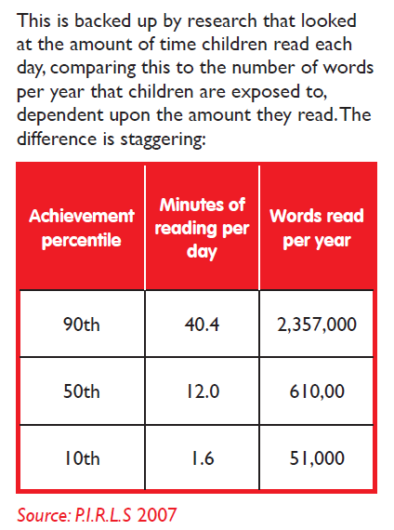
At Isle of Ely Primary, we firmly believe that ‘Words Are Power’.
The more words a person knows, potentially the better their life chances could be.

Slide 6

Words are powerful!
Lots of jokes are based upon word play…
The man who recently fell into an upholstery machine is now fully recovered.

Slide 7
Vocabulary Knowledge
Listening comprehension depends on knowledge of words.
The meanings of individual words contribute to the meanings of sentences and therefore to understanding.
Females tend to master language more quickly than males.
Women use around 7,000 words a day, whereas men use about 2,000.

Slide 8
Vocabulary Knowledge
After the age of five, oral conversation is a much less effective way of developing vocabulary knowledge.
Reading and teaching of words, phrases, metaphor and idiom takes over at this point.
These are key elements in developing written language.

Slide 9

The Importance of Reading
slim bandy
munching buckle
prance elegant
bold

Slide 10
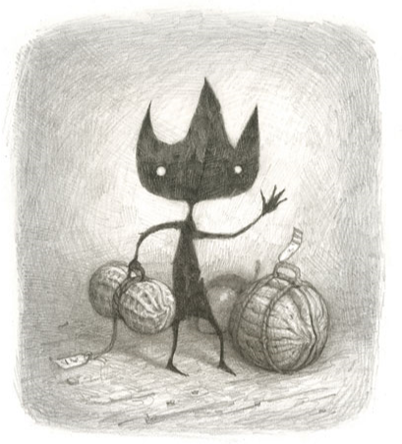
eric by Shaun Tan
foreign, pronounce, pantry, cultural, intensity, excursions, exasperating, speculation, unresolved
‘I could be a local expert, a fountain of interesting facts and opinions.’

Slide 11
Words Are Fun!
I couldn't quite remember how to throw a boomerang, but I knew eventually it would come back to me.

Slide 12
Reading for Pleasure
My child says reading is ‘boring’!
There are many reasons why this may be the case, including:
The child has not yet been taught the ‘basic skills’ needed to read.
The child has not yet found the ‘right book’ to ‘hook’ them into reading.
The child is reading books that are too difficult, therefore reading is hard work with little reward.
The child has not yet been able to apply the reading skills they have learnt into ‘real-time’ reading.
The child sees reading as ‘uncool’.
The child has little experience of role models in reading, be it at home or elsewhere.

Slide 13
Reading For Pleasure
Develop an ethos and an environment that excites, enthuses, inspires and values reading
Use high quality texts with depth and interest in story, character, illustration, vocabulary, structure and subject matter
Read aloud
Be knowledgeable about children’s literature
Understand the importance of illustration in reading both in terms of creating a text and responding to a text
Use drama and role play to help children to understand and access texts

Slide 14
Reading Strategies
Search for something you know e.g. igh, ay
Look for similarities
Use the first phoneme and cross check with the picture
Read to the end and think what fits
Rereading the sentence
Reading with fluency
Identify phonemes and then blend
Chunk
Analogy
Find words within words

Slide 15
Key elements of the full profile of successful reading are:
Decoding
Recognising sight words
Reading groups of words as phrases
Responding to punctuation
Predicting the meaning of certain words they do not already know
Inferring the meaning of a word or phrase
Keeping a constant check on what has been read to check it made sense

Slide 16
Key elements of the full profile of successful reading are:
Making connections to other books or prior knowledge in order to deduce and infer successfully
Thinking about the character’s feelings / thoughts / actions
‘Visualising’ what has been read in order to comprehend better
Questioning’ what has been read in order to comprehend better

Slide 17
Key elements of the full profile of successful reading are:
Deducing information from clues the author has given in order to ‘complete’ what has been read
Inferring what the author meant in a particular situation by activating prior knowledge and combining this information with words from the author to make meaning
Critiquing and evaluating what has been read

Slide 18
Key Message
READ
share, discuss, question and ENJOY!

