Slide 1
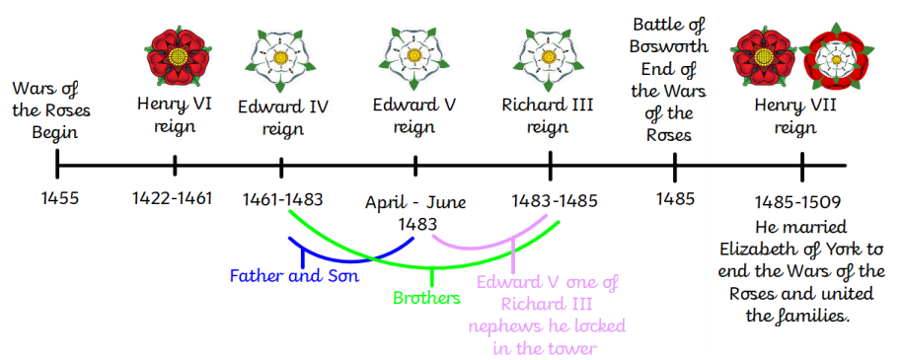
Knowledge Organiser
Year 3 - Spring Term B
History – The War of the Roses and Henry VII
Key Figures
King Edward III | Reigned from 1327-1377. Both the House of Lancaster and the House of York were descendants of Edward III.
King Henry VI | Reigned from 1422–1461 and 1470-1471 (39 years and then 1 year) House of Lancaster A weak king who suffered bouts of madness.
King Edward IV | Reigned 1461–1470 and 1471-1483 (22 years) House of York A strong king and military leader
King Richard III | Reigned from 1483–1485 (2 years) Named protector for Edward V. Accused of killing his nephews, the two princes in the tower.
The Two Princes in the Tower – Edward V and his brother Richard | Edward V reigned for 2 months in 1483. He was two young to rule and so his uncle, Richard III, was named Protector. Stayed at the Tower of London and suddenly disappeared.
King Henry VII (Henry Tudor) | Reigned from 1485–1509 (24 years). House of Tudor although he descended from the House of Lancaster. Defeated Richard III at the Battle of Bosworth. Married Elizabeth of York to unite the two warring houses.
Vocabulary
Civil war | War between different sides in the same country.
War of the Roses | Civil war for control of the throne of England. It was fought between two rival branches of the royal House of Plantagenet
House of Lancaster | A branch of the royal Plantagenet family represented by a red rose.
House of York | The other branch of the royal Plantagenet family represented by a white rose
Tudor | English royal dynasty which held the throne from the accession of Henry VII in 1485 until the death of Elizabeth I in 1603
Battle of Bosworth | The last battle in the War of the Roses fought on 22 August 1485. Henry Tudor defeated Richard III.
Protector | A person in charge of a monarchy when the monarch is deemed incapable.

